Slide 1





WHAT WE DO
Interiors and exteriors, indoors and out.
Painting
Landscaping
Property work
Commercial properties
Outdoor spaces
500+
98%
5.0
Spaces improved
On-time completion
Average rating
GET A CLEAR ESTIMATE.
(512) 348-6433
[TBC: QR]
(512) 348-6232
choosecosmic.com
Notes:
print/01-hanger-estimate-back

Slide 2


WE CARE,
IT SHOWS.
Property services.
Done properly.
Get a clear estimate
Notes:
print/01-hanger-estimate-front

Slide 3
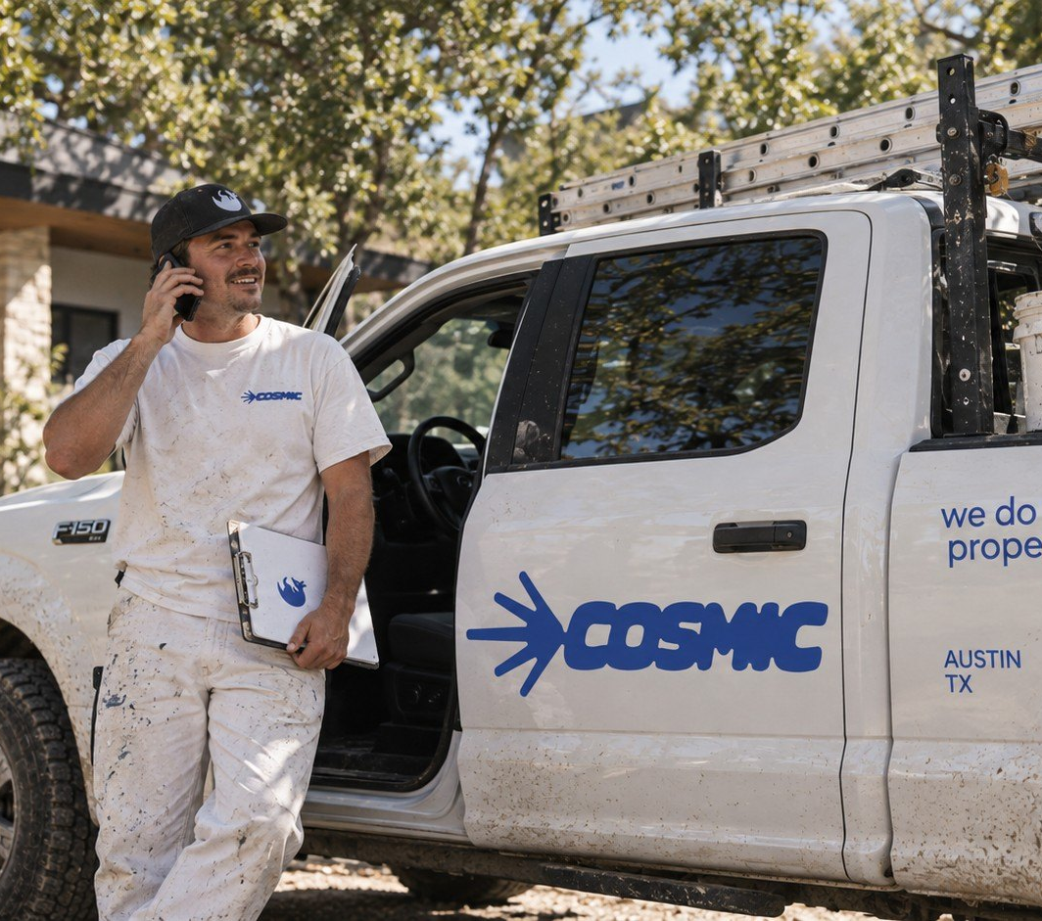
SORRY FOR THE TRUCKS.
We'll keep it clean and quiet.
Thinking about your place?
Ask for a clear estimate while we're here.
WORKING ON YOUR STREET
Address
[TBC: JOB ADDRESS]
Dates
[TBC: DATES]
Get a clear estimate
(512) 348-6433
(512) 348-6232
choosecosmic.com
Notes:
print/02-hanger-notice-back

Slide 4



NEIGHBOR NOTICE
WE'RE WORKING ON YOUR STREET.
Property services.
Done properly.
Notes:
print/02-hanger-notice-front

